Slide 1
INFO251 – Applied Machine Learning
Lab 10
Emily Aiken

Slide 2
Announcements
PS5 solutions posted tomorrow
PS6 due Monday April 18
PS7 released Monday April 11, due Monday May 2
Quiz 2 on Thursday, April 28

Slide 3
Remaining Labs
Today: Deep learning
April 13: Unsupervised learning
April 20: Quiz review
April 27: Applied machine learning start-to-finish

Slide 4
Topics
Regularization for neural networks
Convolutional neural networks (CNNs)
Recurrent neural networks (RNNs)

Slide 5
Regularization in Neural Networks
Option 1: L1 or L2 regularization
Cost function modified with penalization for size of weights
Option 2: Dropout
In training, drop a random set of nodes from a layer at each optimization batch
Hyperparameter: Which layers to add dropout to
Hyperparameter: Share of nodes to drop (between 0 and 1)
In prediction, use all nodes
For more: Srivastava et al. (2014). “Dropout: A simple way to prevent neural networks from overfitting.” JMLR. [Link]

Slide 6
Convolutional Layers
Goal: Capture the spatial dependencies in parts of an image
Multiply a kernel matrix (“filter”) k by subsets of the input image
Hyperparameter: Size of k (often 3x3, 5x5, or 7x7)
Learn: The weights of k
Stride: How to shift the kernel matrix
Hyperparameter: Stride value (integer)

Slide 7
Convolutional Layers
Channels: Number of ”layers” in the input image
Grayscale: 1 channel
RGB: 3 channels
RGBA: 4 channels
Same filter size and stride length, but each channel has different weights
Outputs of channels are summed up

Slide 8
Pooling Layers
Goal: Reduce size of convolved layer to decrease compute cost
Again, operates kernel matrix k over the convolved matrix
Hyperparameter: Size of k (usually 2x2)
Hyperparameter: Stride width (usually 2)
Max pooling: Return maximum value in area covered by kernel
Average pooling: Return average value in area covered by kernel

Slide 9
Convolutional Neural Network Structure
Convolutional layer
Pooling layer
Convolutional layer
Pooling layer
Flatten
Fully connected layer(s) (activation: sigmoid/tanh/relu)
Output layer (activation: determined by problem type)
Repeat convolution followed by pooling any number of times. Option to add dropout after pooling.
Add any number of fully connected layers. Option to add dropout.

Slide 10
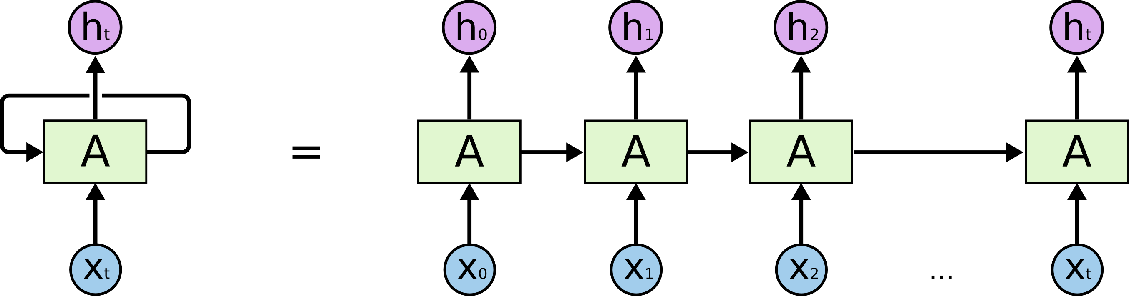
Recurrent Neural Networks (RNNs)
Used for timeseries-related problems
Input can be of arbitrary length
Challenge: Long-term dependencies
Long short-term memory networks (LSTMs) address this issue

Slide 11
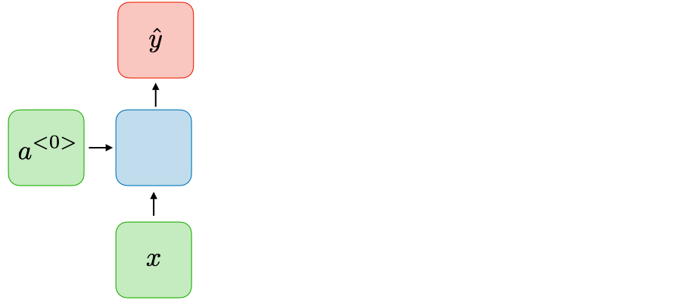
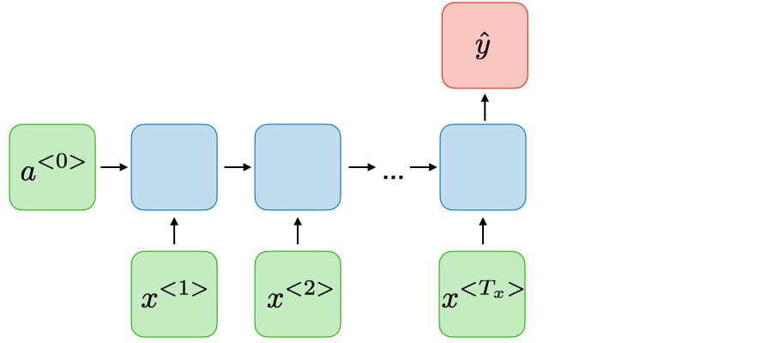
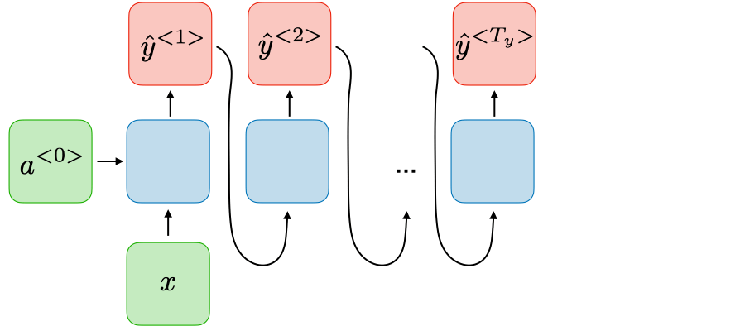
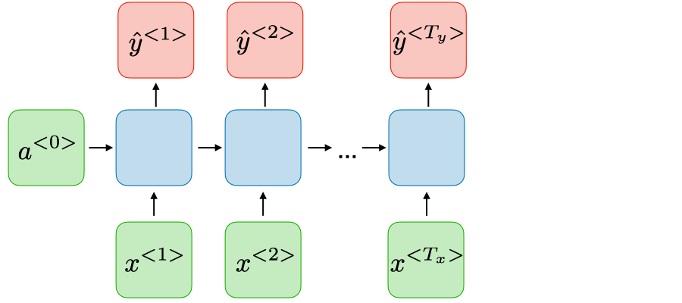
Recurrent Neural Networks (RNNs)
One-to-one
e.g. standard NN classification
Many-to-one
e.g. sentiment classification
One-to-many
e.g. music generation
Many-to-many
e.g. translation

